Slide 1


SurveySparrow
Lazar Milicevic
Introduction
Leveraging SurveySparrow to Enhance Productivity and Customer Experience at Owkin

Slide 2
Agenda
1. How Can Owkin Benefit from SurveySparrow?
3. Empowering the Product Team with SurveySparrow
5. Integration with Zendesk and Other Tools
7. Diverse Survey Distribution Channels
9. Implementation Steps
2. Overview of SurveySparrow's Capabilities
4. Enhancing the Support Team's Efficiency
6. Advanced Customer Satisfaction Analysis
8. Survey Types for Comprehensive Insights
10. Q&A

Slide 3
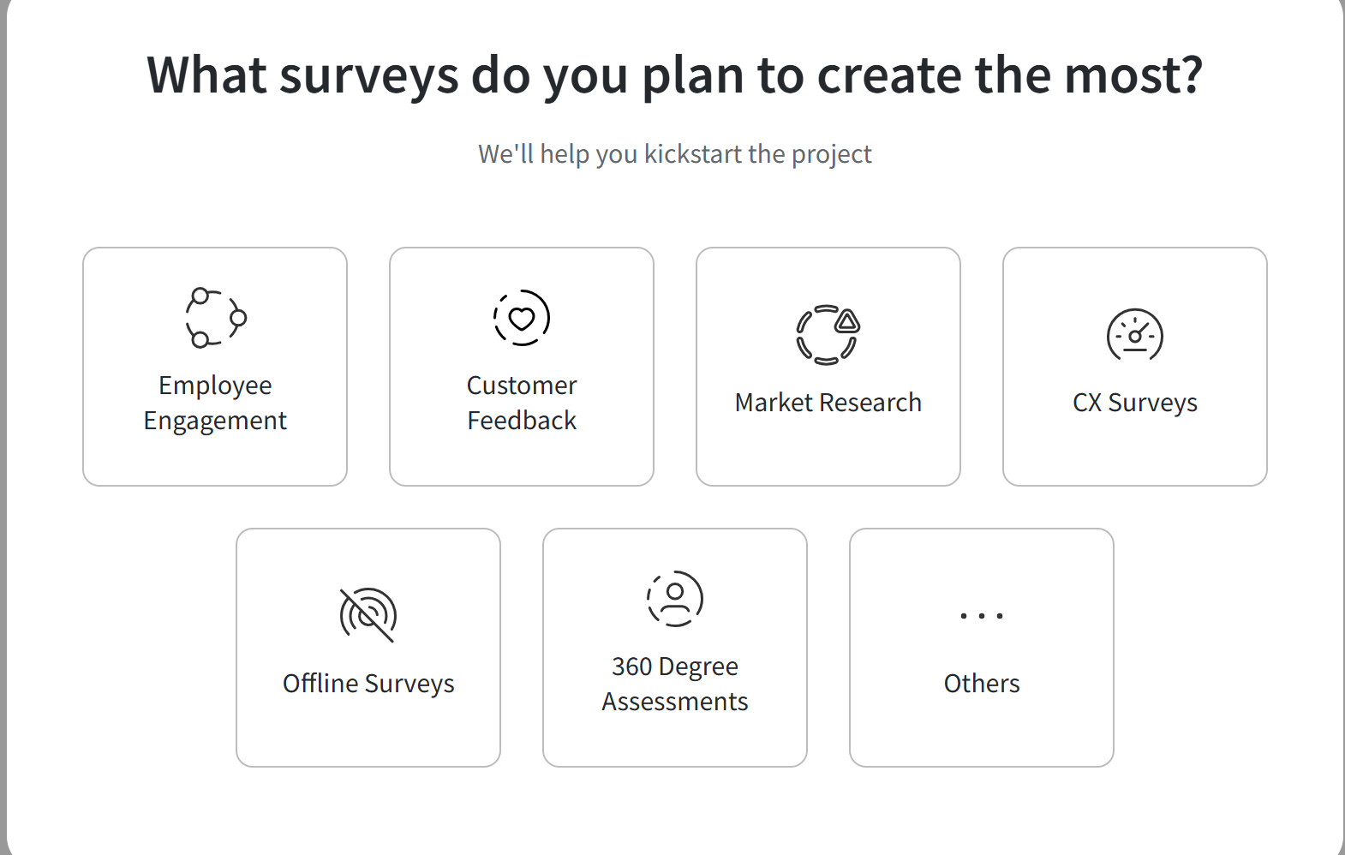
Introduction
Customer success: SurveySparrow - Introduction – 18.02.2025
How Can Owkin Benefit from SurveySparrow?
We will explore how SurveySparrow can revolutionize the way our team at Owkin gathers feedback, analyzes data, and enhances support processes.
Streamline support and ticket management
Gain deeper insights into customer satisfaction
Optimize data-driven decision-making

Slide 4
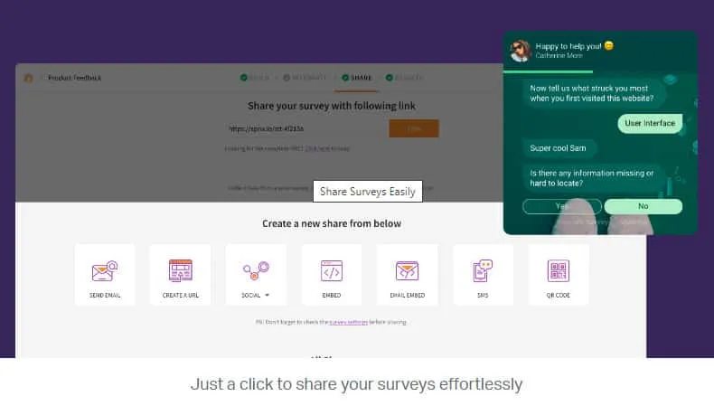
Overview of SurveySparrow's Capabilities
Customer success: SurveySparrow - Introduction – 18.02.2025
✅ SurveySparrow offers a robust suite of features:
Conversational Surveys: Engage respondents with chat-like surveys, leading to higher completion rates.
Omnichannel Distribution: Share surveys via email, web links, SMS, Slack, and more.
Advanced Analytics: Utilize real-time reports and AI-powered tools like CogniVue for in-depth analysis.
Seamless Integrations: Connect effortlessly with platforms such as Zendesk, Slack, Google Sheets, and Excel Online.
API and Webhooks: Facilitate advanced automation and data workflows.

Slide 5
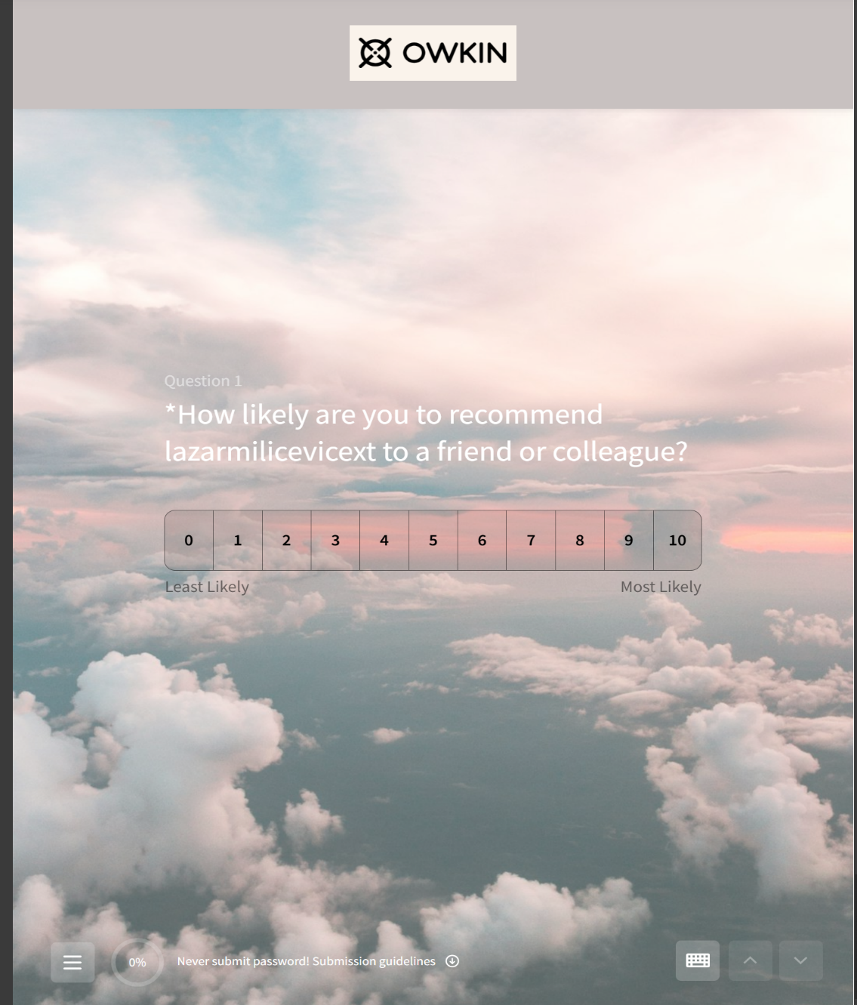
Product Team with SurveySparrow
Customer success: SurveySparrow - Introduction – 18.02.2025
How we can use it ?
✅ 1. Analyzing Customer Satisfaction (Net Promoter Score - NPS)
Automated Feedback Collection: Gather insights from both internal and external users seamlessly.
Identifying Key Satisfaction Drivers: Pinpoint factors influencing user contentment.
Data-Driven Decision Making: Leverage trends to inform strategic choices.
Example: By integrating SurveySparrow, we can dispatch surveys to users post-ticket resolution in Zendesk, monitoring NPS to uncover critical issues and improvement opportunities.

Slide 6
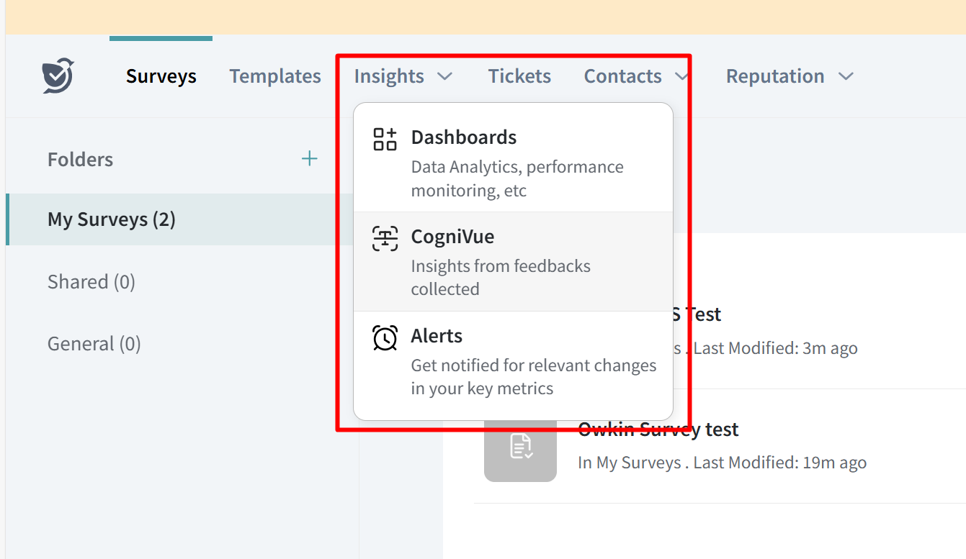
Enhancing the Support Team's Efficiency
Customer success: SurveySparrow - Introduction – 18.02.2025
What can be done:
Post-Ticket Feedback Automation: Solicit user evaluations immediately after ticket closure.
Analyzing Common Issues: Detect recurring problems and assess solution effectiveness.
Example 1: Upon ticket closure in Zendesk, users receive an automated survey to rate their support experience. Responses are analyzed to identify prevalent issues causing dissatisfaction, enabling proactive solutions.
Example 2: Embedding surveys within our internal documentation allows users to provide immediate feedback on content utility.
Example 3: We can embed survey directly to the abstra website, to be always available.

Slide 7
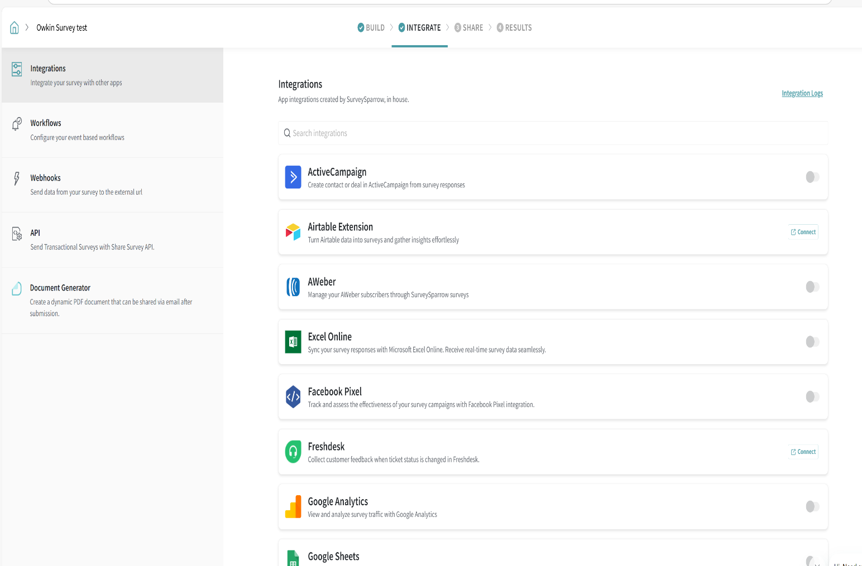
Integration with Zendesk and Other Tools
Customer success: SurveySparrow - Introduction – 18.02.2025
What can be done:
SurveySparrow can be integrated with various platforms to improve workflow:
Zendesk: Automate survey for post-ticket closure.
Slack: We can receive instant notifications for negative feedback.
Google Sheets / Excel Online: Centralize data storage for deeper analysis.
ActiveCampaign / AWeber: Automate user communications based on feedback.
Advantage: Integrating SurveySparrow ensures feedback data becomes an integral part of Owkin's ecosystem, supporting strategic decision-making.

Slide 8
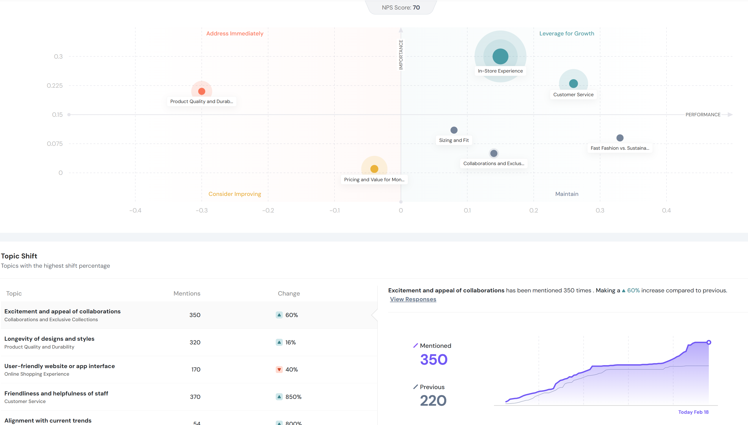
Advanced Customer Satisfaction Analysis
Customer success: SurveySparrow - Introduction – 18.02.2025
What can be done:
SurveySparrow's CogniVue AI offers cutting-edge text analytics:
Root Cause Analysis: We can see underlying issues affecting user satisfaction.
Sentiment and Keyword Analysis: We can se deep sentiment Analysis, user emotions and highlight critical topics.
Identifying Hidden Patterns: Reveal trends within feedback to inform proactive measures.
Benefits for Owkin:
Automated Feedback Analysis: Efficiently process extensive user input.
Predictive Issue Identification: Anticipate and address potential problems before escalation.
Branded Surveys, all results and feedbacks in one place, in dedicated SurveySparrow dashboard, and more.

Slide 9
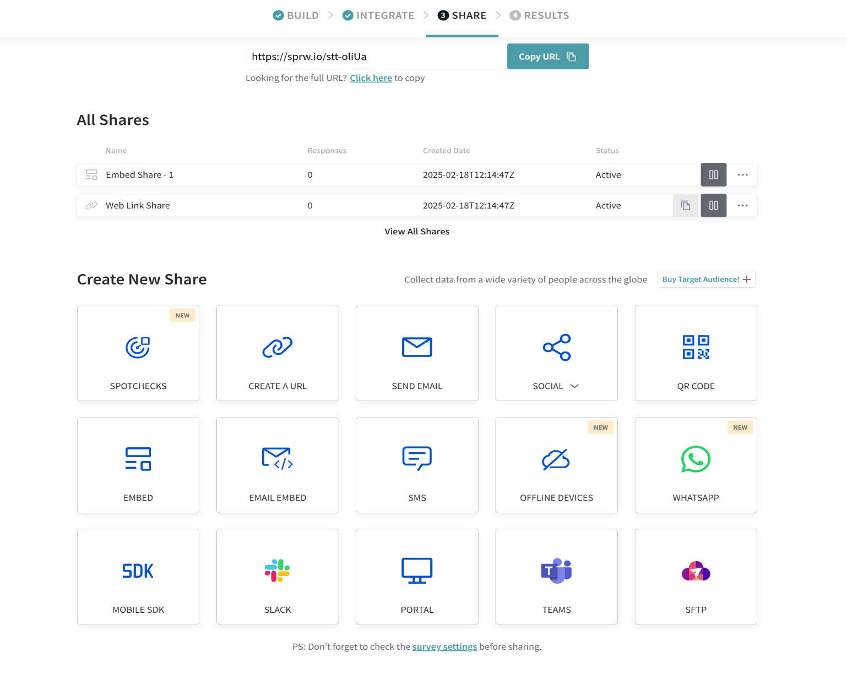
Survey Distribution Channels
Customer success: SurveySparrow - Introduction – 18.02.2025
What can be done:
SurveySparrow supports multiple channels:
Email Surveys: Direct engagement with users post-interaction.
Web Surveys: Embedded forms on Owkin's platforms for seamless feedback collection.
SMS Surveys: Quick data gathering via mobile devices.
Shareable Links: Flexible distribution across various platforms.
Practical Application: Embedding surveys within our internal documentation allows users to provide immediate feedback on content utility.

Slide 10
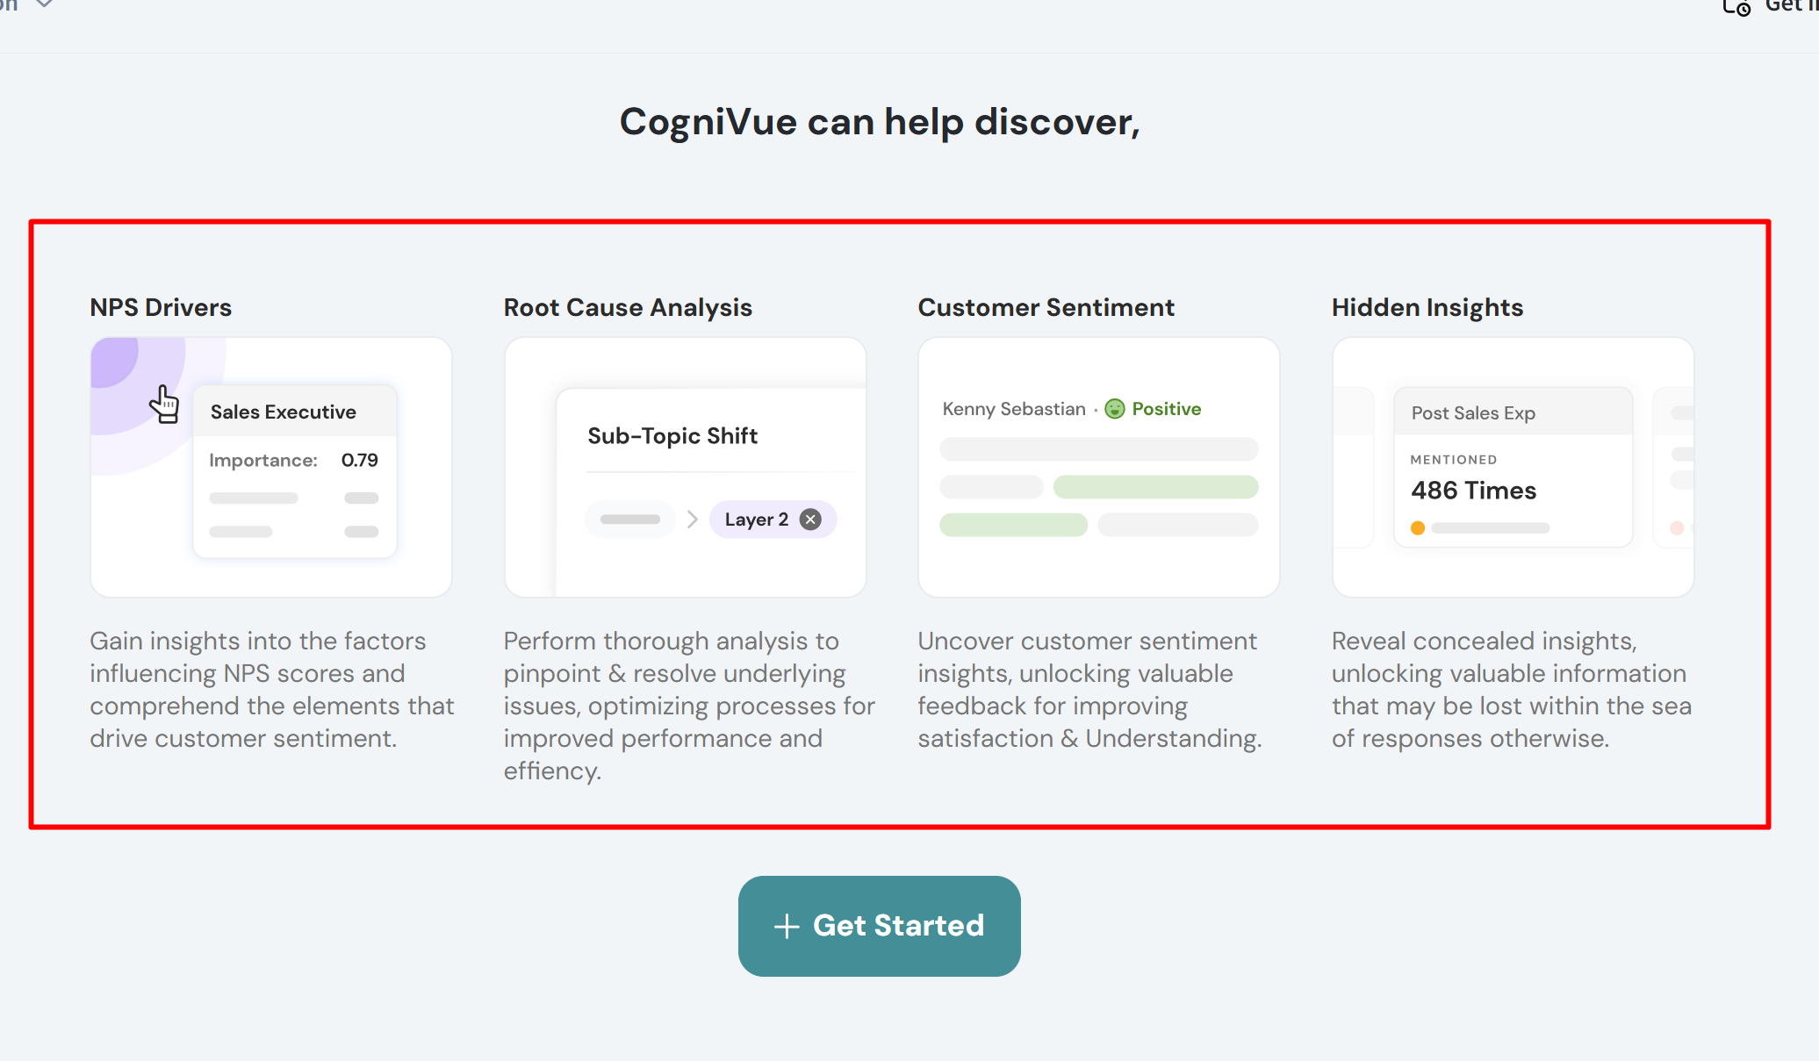
Implementation Steps
Customer success: SurveySparrow - Introduction – 18.02.2025
for Success at Owkin
Identify Key Use Cases: Determine critical areas where SurveySparrow adds value.
Develop Pilot Surveys: Design initial surveys for support and product teams.
Integrate with Existing Tools: We can connect SurveySparrow with Zendesk and other Slack.
Automate Feedback Processes: Set up workflows for continuous data collection and analysis. ( For example emended survey to the abstra website)
Continuous Improvement: Use insights to refine processes and make user satisfaction better.

Slide 11

Q&A
Customer success: Weekly Support Report – 30.01.2025
Any questions ?

Slide 12
Thank you!

